Slide 1
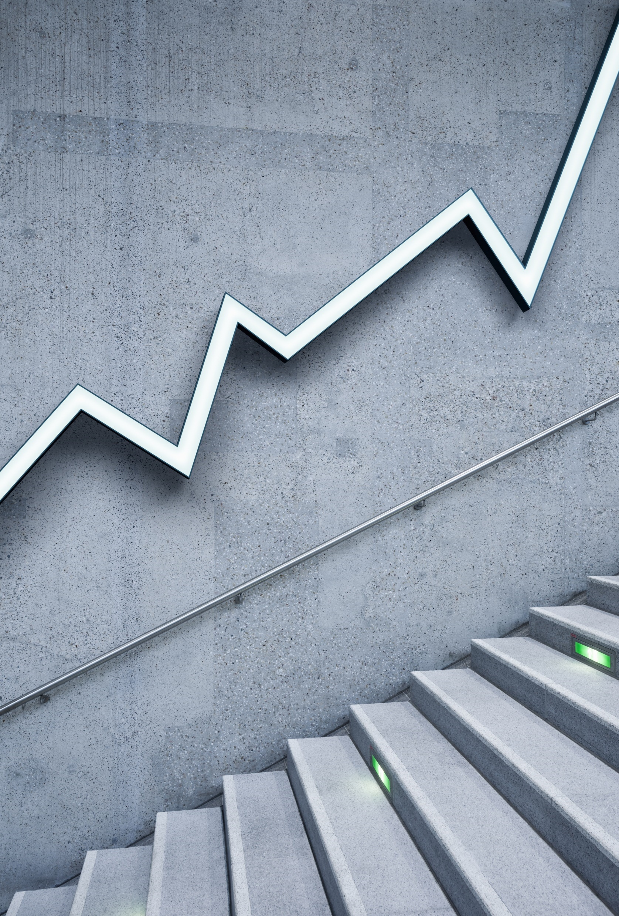
Tech Fest 2022 Topic:Fleet Risk Business Insight
TEAM id: ha226988

Slide 2
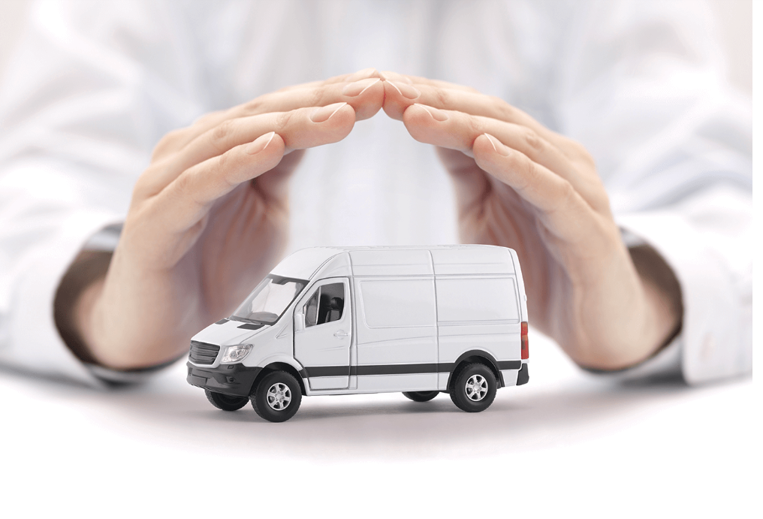
Introduction:
What is Fleet risk Management ?
Fleet risk management is the procedure used by businesses to guarantee the security and safety of its drivers, other fleet workers, and vehicles. It also entails creating backup strategies to reduce risks as they materialise.

Slide 3

Objective
Developed a machine learning algorithm to determine the risk score for the specific provider and driver.
The risk of the company is displayed on a dashboard. We ought to be able to compare the risk scores of various drivers using the dashboard as well.

Slide 4
Data Dictionary
ID : ID of the Driver
Age : Age of the Driver
Driving Hours : Drivers' working hours
Date :
Number_of_trips : Total Number of trips
Avg_Daily_Safety_score : The Safety Score is a value between 0 and 100, where a higher score indicates safer driving. Most
drivers are expected to have a Safety Score of 80 or above.
Avg_Daily_Reward_score : The driving score is given on a scale of 0 to 100. The higher the score, the better the driver
Total_Miles_done : Total miles completed by the driver
Number_of_tickets_received : A written notice that you receive when you are caught disobeying traffic
Driver_Risk : Risk of the driver

Slide 5
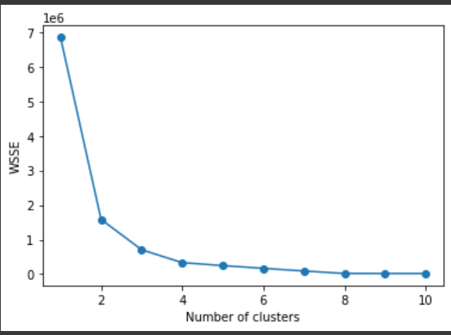
Clustering Segmentation
K means Clustering :
K -means clustering algorithm is an unsupervised algorithm and it is used to segment the interest area from the background.
Created the fleet cluster using
Kmeans.

Slide 6
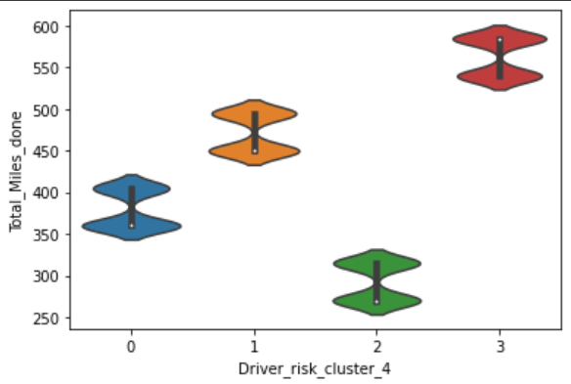
Created the number of clusters using voilen plot
Here 3 : Very High Risk , 1: High Risk , 0: Low Risk , 2: Very Low Risk

Slide 7

Machine Learning Models
A machine learning model is a file that has been trained to recognize certain types of patterns. In this Project we are calculating the risk score by using these Classification techniques.
We have used five different ML algorithms .
1) Multinomial Naïve Bayes
2) Support Vector Machine using Linear Kernel
3) Support Vector machine using rbf Kernel
4) Decision Tree
5) Logistic Regression

Slide 8
Best Model
Decision Tree is the best fit model for calculating both company and driver risk . We found it by using the accuracy of the models.

Slide 9
Business Inference

